Slide 1
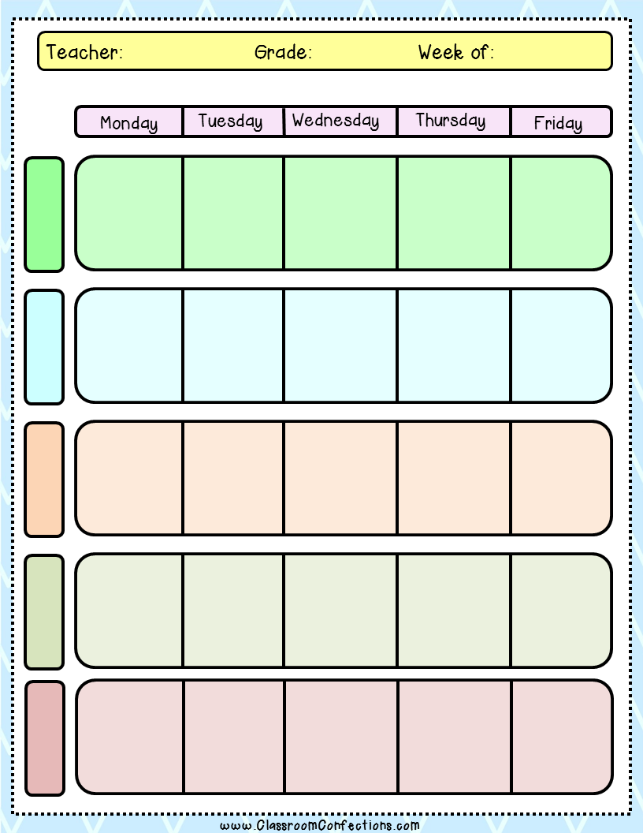
Mrs. Illies
4th Grade
Feb. 2 –Feb. 6
Reading
Writing Prompt
Opinion Writing
Lesson 10 & 11
Vocab Intro
Vocab Notes
Hand out
Sign & return
ABC Order
Seq of Events:
GG 18 & 23
Vocab Story
Vocab Match
Read Story
Seq of Events
WB 193
Vocab Act Out
Story w./ Partners
Vocab Pretest
ST Questions
Seq of Events
Activity
Vocab
Listen to Story
Selection Test
English
Adverbs
How When Where
Proj 17.6
WB 199
Skill :
Sound/Spelling T 111
Adverbs
Freq. Inten.
Proj. 17.7
WB 200
Skill:
Suffixes GG 19 & 25
Adverbs
Part of Sent.
Proj. 17.8
WB 201
Skill:
Sound/Spell Activity
Extra Practice
English Bk
234 & 235- WB 111
238 & 239- WB 115
Adverb Flip Book/Bone
Suffixes Activity
Adverb Game
LA Test
Moby Max
Spelling
Unit 21
Go over words
Sign & Return
Pgs. 138 & 139
Unit 21
Pg. 140
Word Work Activity
Unit 21
Pretest
Pg. 141
Spelling Game
Unit 21
Pgs. 143
Unit 21
Test
Lesson 76
Math
Lesson 77
Lesson 78
Lesson 79
Lesson 80
Part 1
S.S./Science
Science Test
Earth History
And Surface
Finish Lewis
And Clark
Activity
SS
Pg. 75-83
SS
Pg. 89-95
Hwork
Pgs. 96-98
Catch Up
Make Fort
Brochure

Slide 2
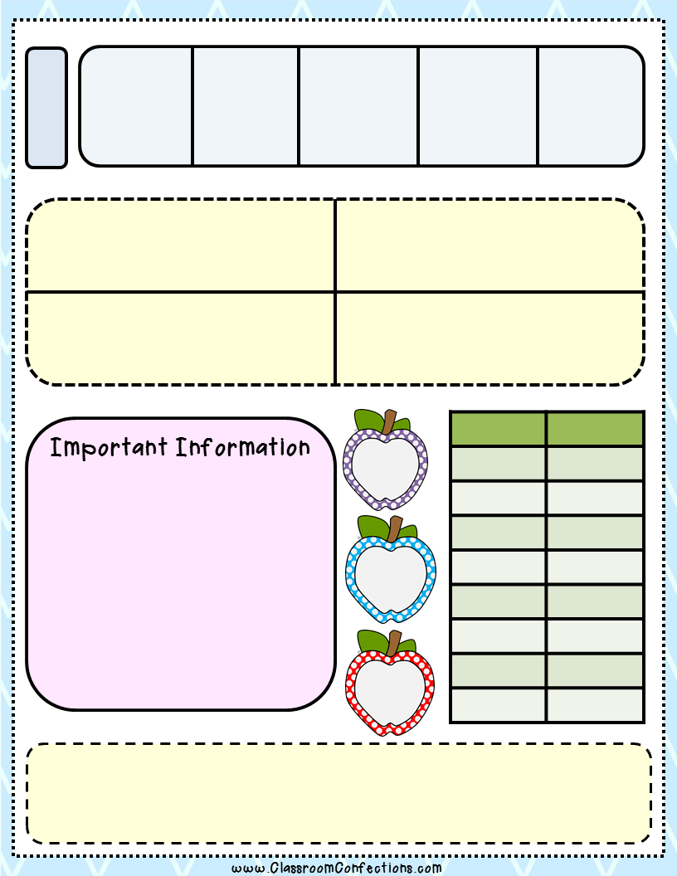
Teaching Meetings
Writing
Opinion
Writing
Opinion
Writing
Opinion
Writing
Opinion
Writing
LUNCH
10:55
Art: Adjective Hair/Newspaper Hearts
Health: Finish My Body

